Slide 1
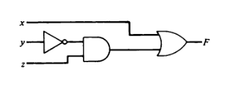
“Control Logic Gates”
Group Presentation:
Team Members:
Ujjwal Upreti
Anish Thakuri
Sagar Giri
Krishna Chauhan

Slide 2
Overview:
Topics in todays presentation:
Circuit Terminology
Flow charts and tables
Examples
Conclusion

Slide 3
Circuit Terminology
Registers:
AR - Address Register
PC – Program Counter
DR – Data Register
AC – Accumulator
IR – Instruction Register
TR – Temporary Register
OUTR – Output Register
INPR – Input Register
SC – Sequence Counter

Slide 4
Circuit Terminology (contd..)
Flip Flops
IEN – Interrupt Enable
FGI – Input Flag
FGO – Output Flag
Others:
D0 – D7 (decoders inputs)
T0 – T15 (Timing Control)
INR – Increment
CLR - Clear

Slide 5
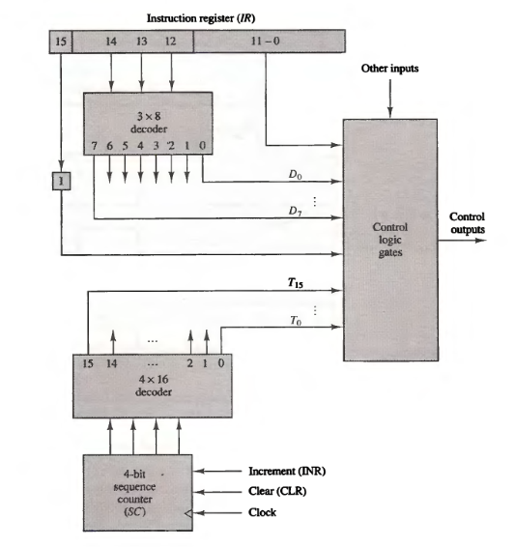
Circuit , Flow charts and tables

Slide 6
Circuit , Flow charts and tables (contd..)
The inputs to this circuit come from the two decoders, the I flip-flop, and bits 0 through 11 of IR.
The other inputs to the control logic are: AC bits 0 through 15 to check check if AC = 0 and to detect the sign bit in AC(15); DR bits 0 through 15 to check if DR = 0; and the values of the seven flip-flops.

Slide 7
Circuit , Flow charts and tables (contd..)
The outputs of the control logic circuit are:
1. Signals to control the inputs of the nine registers
2. Signals to control the read and write inputs of memory
3. Signals to set, clear, or complement the flip-flops
4. Signals for S2, S1, and S0 to select a register for the bus
5. Signals to control the AC adder and logic circuit

Slide 8
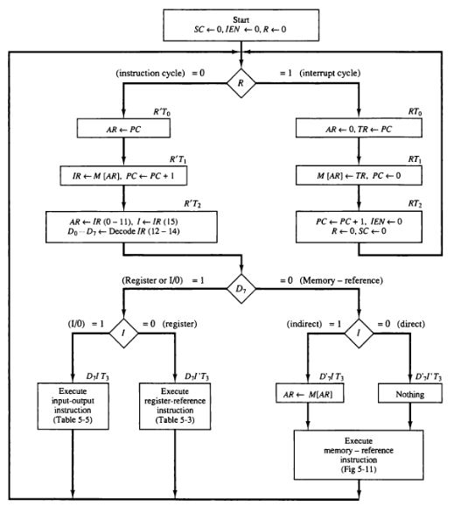
Circuit , Flow charts and tables (contd..)

Slide 9
Examples:
R'T0: AR PC
R'T2: AR IR(O-11)
D7IT3: AR M[AR]
RT0: AR 0
D5T4: AR AR + 1
These are the transfer of information from register or memory to AR.

Slide 10
Examples:
LD(AR) = R'T0 + R'T2 + D7'IT3
CLR(AR) = RT0
INR(AR) = D5T4
Read = R'T1+ D7'IT3 + (D0 + D1 + D2 + D6)T4

Slide 11
Conclusion:
Control Logic gates is the crucial element in the design of basic computer.
All of the algorithms and mathematics that can be described with Boolean logic
Control Logic Gates are used to control read and write control in the memory.
Used to trigger the flip-flops.
Control Logic gates generates signals to control the Accumulator(AC) adder and other logical circuits that follow after Control logic gates circuit block.

Slide 12
Sources:
Computer System Architecture (3rd Edition) – M. Morris Mano
Notes of Computer Architecture (CSC. 201) - Third Semester Prepared By: Arjun Singh Saud from www.bsccsit.com
http://en.wikipedia.org/wiki/Logic_gate

Slide 13
THANK YOU

